Slide 1
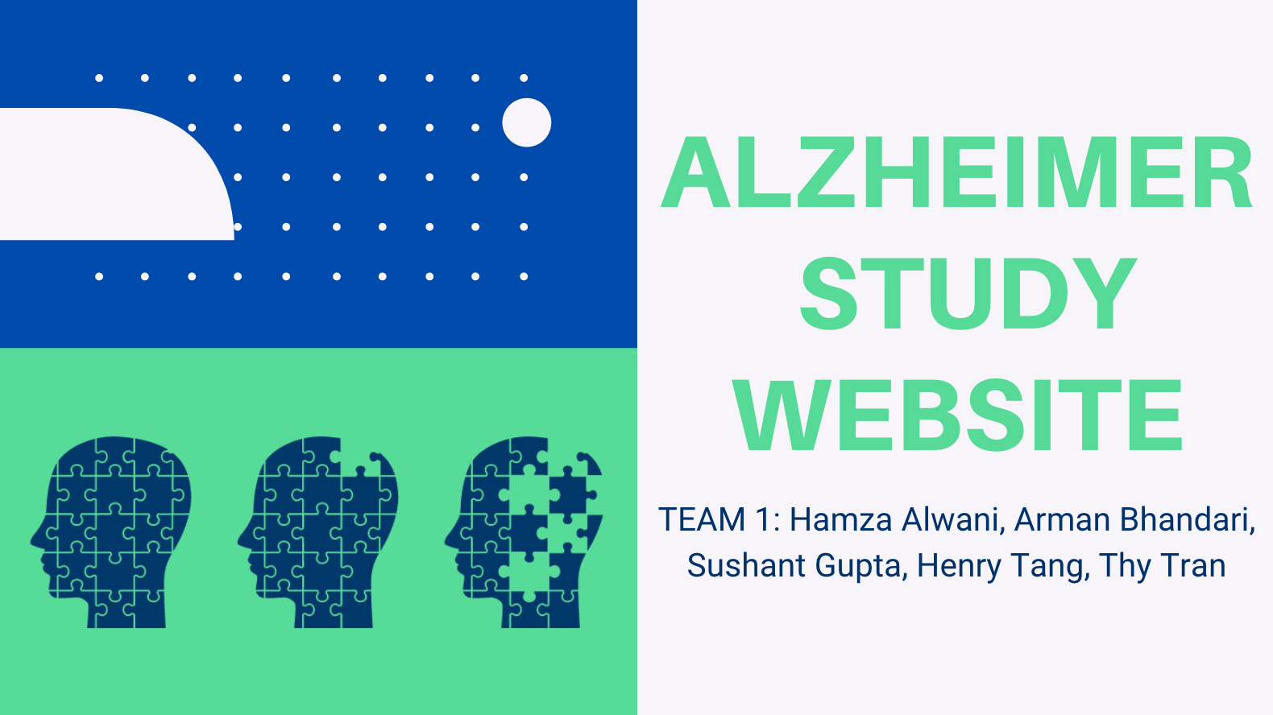
https://github.com/Hamza-Alwani/CSE3311_Alzheimers
1
Notes:
Hamza

Slide 2
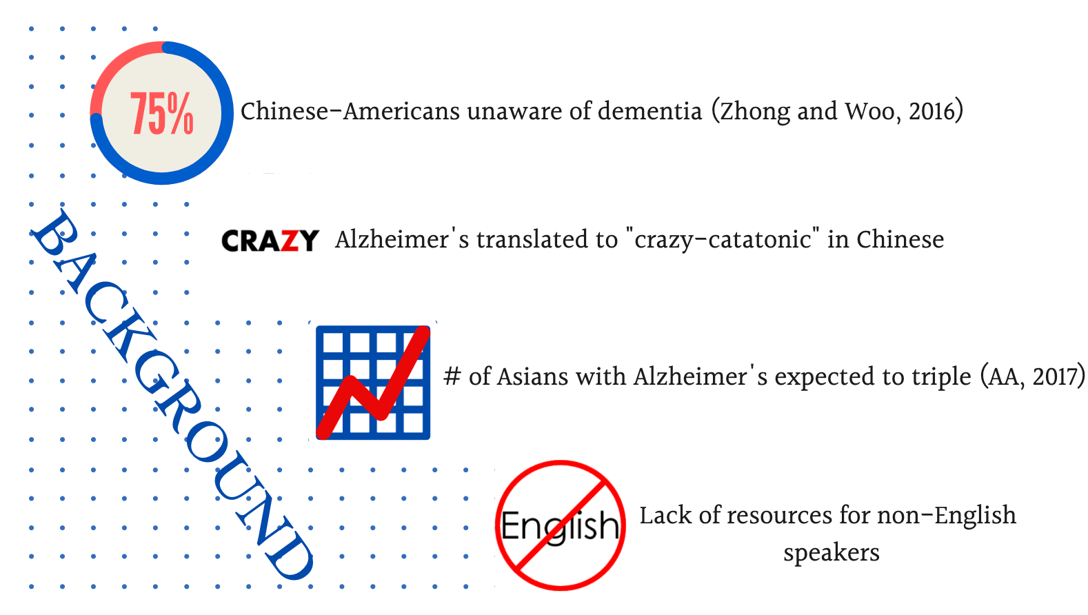
2
Notes:
Hamza
http://depts.washington.edu/mbwc/news/article/bridging-the-gaps-in-asian-american-dementia-care, https://www.ncbi.nlm.nih.gov/pmc/articles/PMC4919263/#:~:text=DISCUSSION-,This%20study%20reveals%20that%20only%20approximately%201%20out%20of%20every,a%20mental%20illness%5B9%5D. ,
3/4 Chinese-Americans do not recognize dementia as a mental illness. As the majority of other Asians, they consider dementia normal aging and thus delay diagnosis and care until symptoms bcomee unmanageable
According to Edie Yau, the director of Diversity & Inclusion at the Alzheimer’s Association, ‘Alzheimer’s disease’ translates into colloquial Chinese as ‘crazy-catatonic disease’. the translation’s association with mental illness can make someone less likely to seek out care later. When your mother’s given a diagnosis of ‘crazy’ or ‘catatonic’, it doesn’t really encourage you to reach out for help and hence not getting proper dementia care.
according to a report published by Alzheimer’s Association in 2017, number of Asians people associated with Alzheimer’s disease are expected to nearly triple in between 2010 to 2030.
however, many healthcare offices don’t have the tools to effectively translate a diagnosis and help non-English speakers, such as first-generation immigrants. That’s where our website comes in.

Slide 3
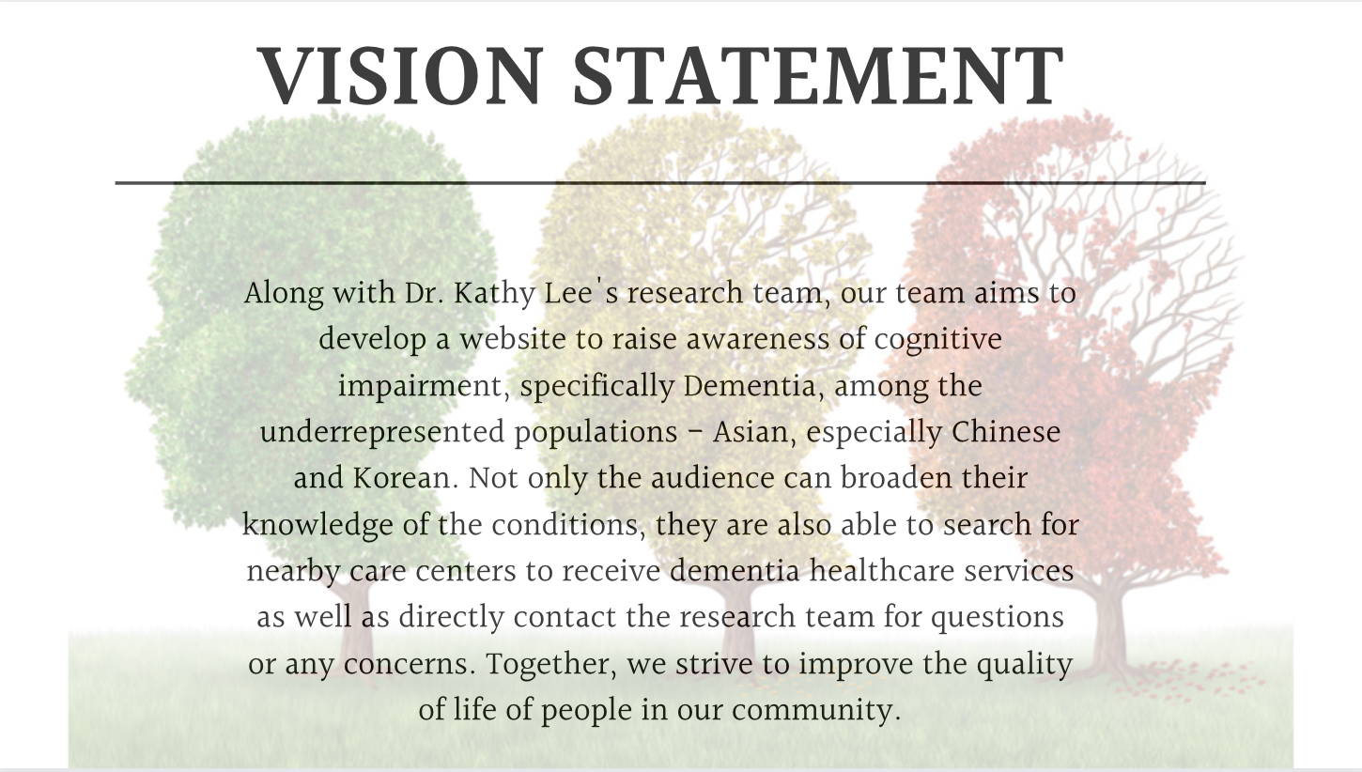
2
3
Notes:
Because of all the reasons stated earlier, we would like to work with Dr. Kathy Lee’s research team to develop a website… awareness of dementia, including Alzheimer’s disease, among the underrepresented population, in this case Asian population, spefically CHinese and Korean Americans.

Slide 4
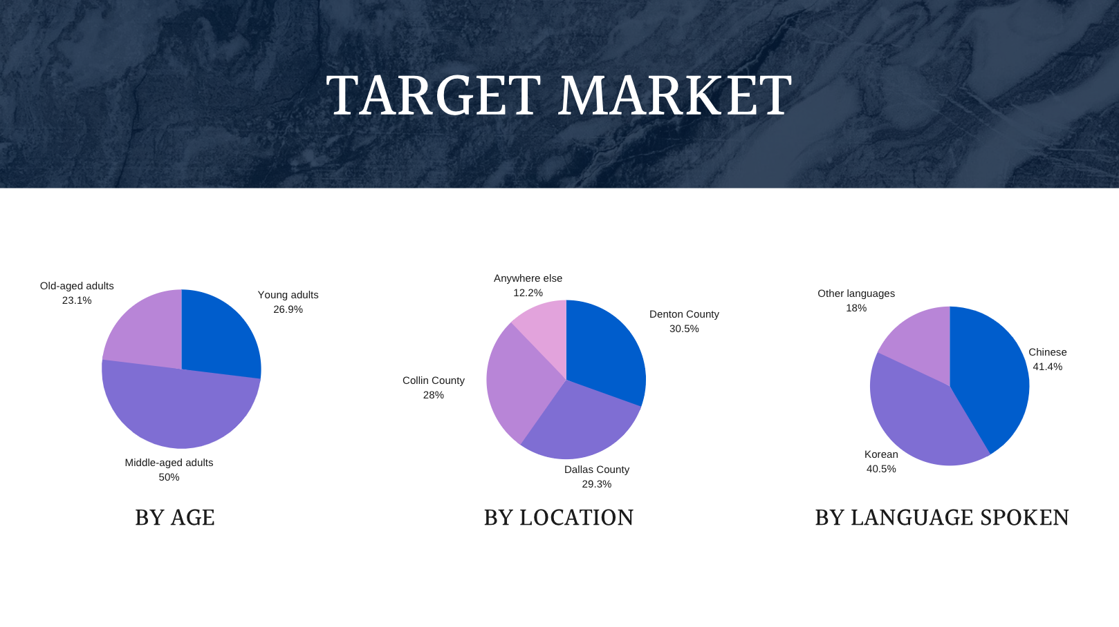
Source: Texas Population Demography
4
Notes:
We have also identified our target market and classified them into 3 categories. By age, since everyone should know somewhat knowledge of dementia, we do expect all adults to be our customers. By analyzing the population data of Texas, we expect 26.9% young age adults (18-35), ~50% middle aged adults (36-62), and 23.1% old-aged adults (above 62). By location, we expect the majority of people from counties with the largest Asian communities, which are COllin, Denton and Dallas county. By language spoken, as said earlier, our main focuses are the Korean and Chinese communities so we expect a large number of Chinese and Korean people. Sine Chinese American make up the largest ethnic group of Asian Americans, we do expect a higher percentage of Chinese Americans than Korean. However, we did not leave out people who speak other languages because our website is also available in English so we will be able to deliver our services to the majority of our country’s population.

Slide 5





FEATURES & USER INTERFACE
Available in English, Chinese, Korean
Work on major platforms (iOS, Android, desktop)
Admin’s page for research team
1
2
3
4
5
Notes:
1: https://www.forbes.com/sites/tonybradley/2013/11/15/android-dominates-market-share-but-apple-makes-all-the-money/#50dca79177d5
2: https://www.blindspot-advisors.com/why-do-websites-look-different-on-different-computers/
3: https://blog.mozilla.org/opendesign/firefox-the-evolution-of-a-brand/
4: https://www.google.com/chrome/
5: https://www.apple.com/safari/

Slide 6
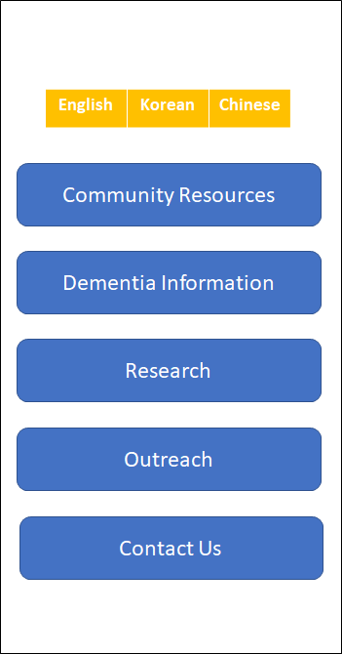
FEATURES & USER INTERFACE
HOME-PAGE
Source: Dr. Kathy Lee’s Slides

Slide 7
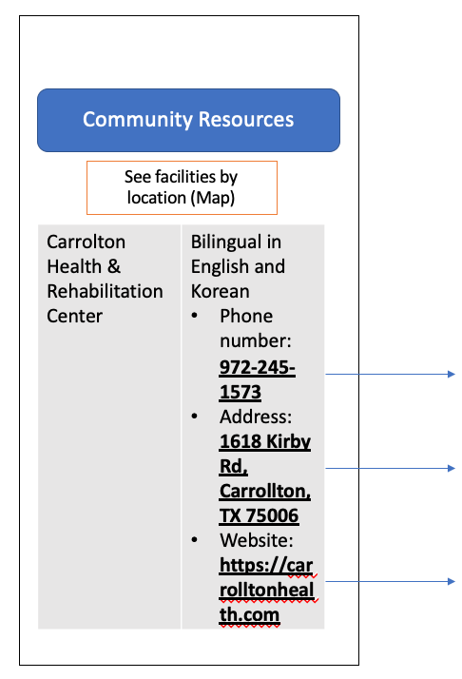
FEATURES & USER INTERFACE
COMMUNITY RESOURCES FEED
Show nearby rehab centers (name, phone #, address, website)
Direct to maps upon clicking “See nearby locations”
Direct to call upon clicking phone number
Direct to maps application
Direct to website
Source: Dr. Kathy Lee’s Slides

Slide 8
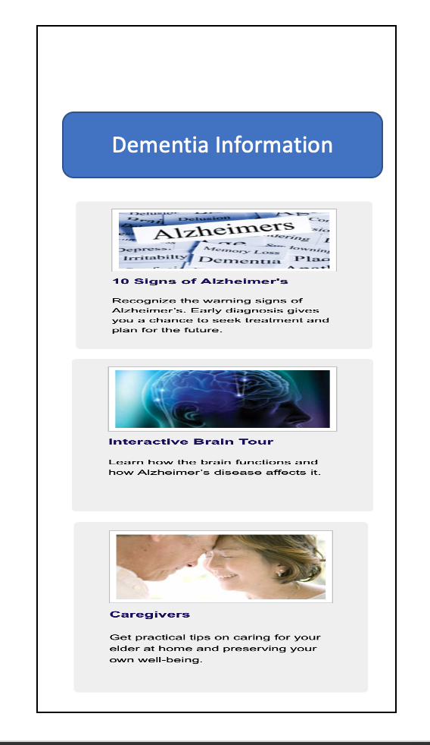
FEATURES & USER INTERFACE
INFORMATION FEED: Informative articles on the diseases & what to do
Source: Dr. Kathy Lee’s Slides

Slide 9
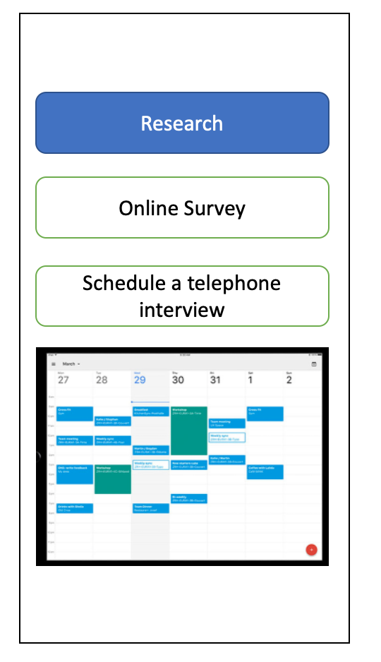
FEATURES & USER INTERFACE
RESEARCH FEED:
Direct to survey website
Schedule a phone interview
Show available times users can pick from -> send users confirmation message upon scheduling -> change time slot from blue to green -> notify research team -> team send users confirmation email
Source: Dr. Kathy Lee’s Slides

Slide 10
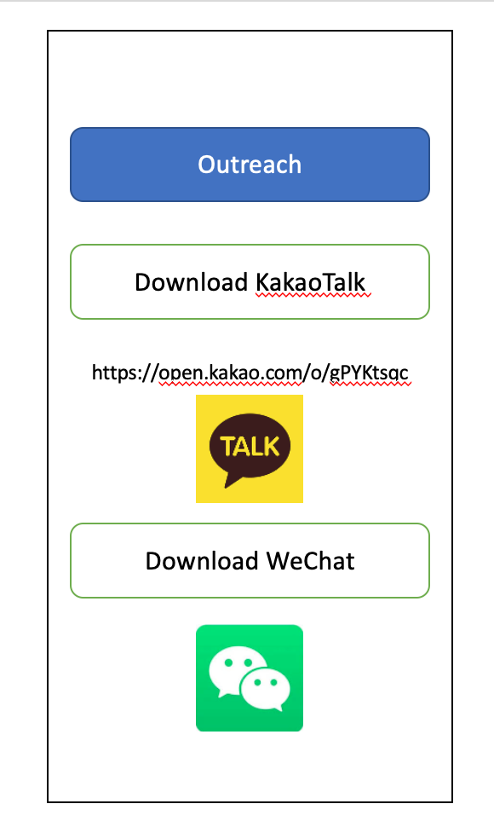
FEATURES & USER INTERFACE
OUTREACH FEED:
Direct to download Kakaotalk
Wechat
Source: Dr. Kathy Lee’s Slides

Slide 11
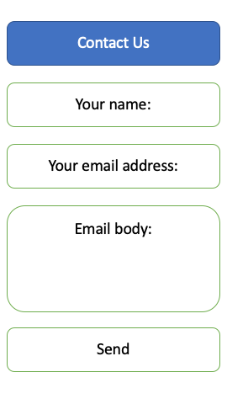
FEATURES & USER INTERFACE
CONTACT US PAGE:
Send research team messages by providing name and email
Source: Dr. Kathy Lee’s Slides

Slide 12
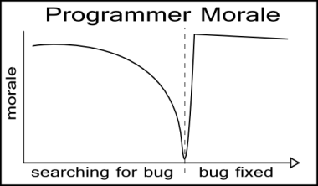
RISKS and Constraints
Specific risks are listed in the written deliverable.
Some of the constraints includes:
Lack of web application development experience
Lack of enough Javascript experience
Virtual meetings
Team coordinations
Strict deadline
1
Notes:
1: https://www.pinterest.com/pin/427982770812748102/

Slide 13
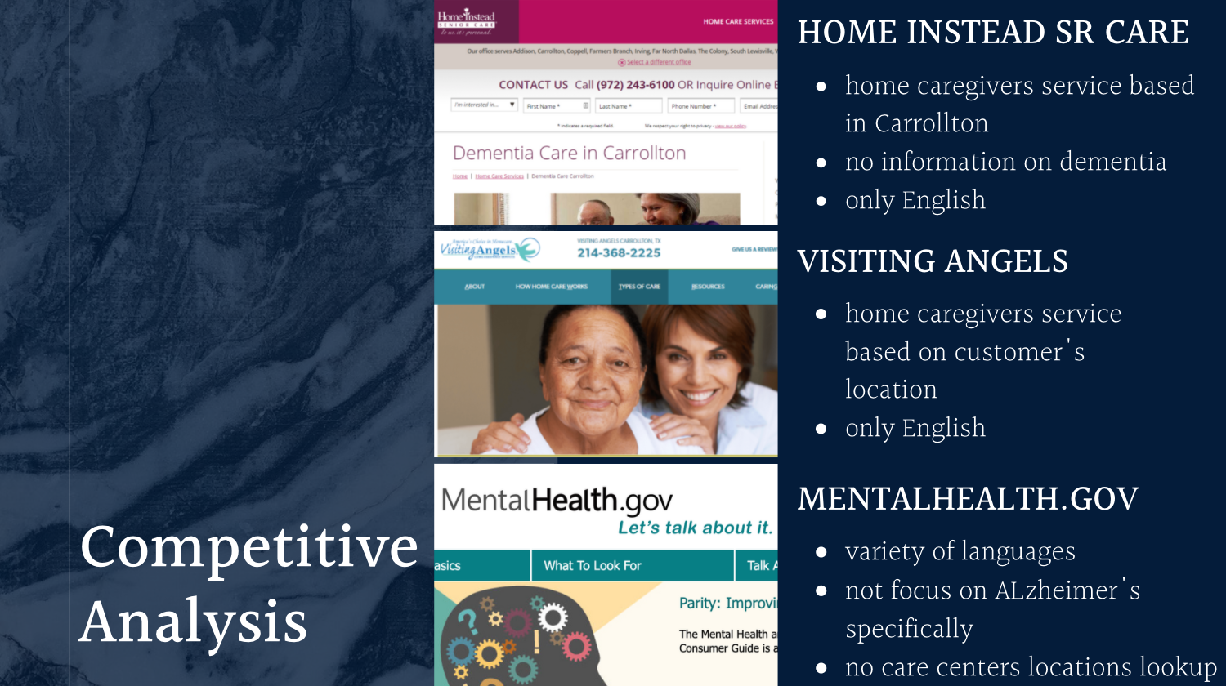
Source: Home instead and MentalHealth.gov

Slide 14
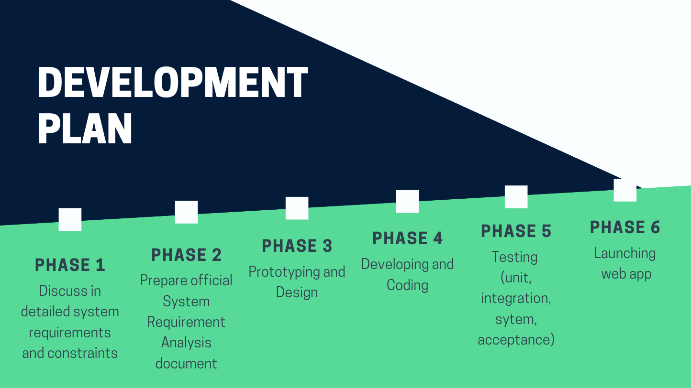

Slide 15
REFERENCES
Dr. Kathy Lee’s slides, https://uta.instructure.com/courses/57602/files/9491615/download
Texas Population Demography, https://www.census.gov/quickfacts/TX
Home Instead SR Care, https://www.homeinstead.com/
MentalHealth.gov, https://www.mentalhealth.gov/
Android Image, https://www.forbes.com/sites/tonybradley/2013/11/15/android-dominates-market-share-but-apple-makes-all-the-money/#50dca79177d5
Desktop Image, https://www.blindspot-advisors.com/why-do-websites-look-different-on-different-computers/
Firefox Image, https://blog.mozilla.org/opendesign/firefox-the-evolution-of-a-brand/
Chrome Image, https://www.google.com/chrome/
Apple Image, https://www.apple.com/safari/
http://depts.washington.edu/mbwc/news/article/bridging-the-gaps-in-asian-american-dementia-care
https://www.ncbi.nlm.nih.gov/pmc/articles/PMC4919263/#:~:text=DISCUSSION-,This%20study%20reveals%20that%20only%20approximately%201%20out%20of%20every,a%20mental%20illness%5B9%5D. ,

Slide 16


